Slide 1
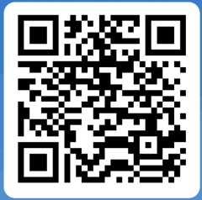
Self-Referral Audiology Service
Patients over the age of 16 can now make an appointment with an advanced audiology practitioner who can assess, treat or refer patients to the appropriate department during the initial visit, removing the need to see the GP.
The Advanced Audiology Practitioner will see patients who suffer from hearing difficulties, bothersome tinnitus and a common balance disorder called BPPV – Benign Paroxysmal Positional Vertigo. For maintenance of hearings aids, please contact your local audiology department.
Online referral is the quickest way for your referral to arrive at the Therapies Hub who will book your appointment.
Visit www.pthb.nhs.wales and search for Audiology, or alternatively scan the QR code below to take you directly to the referral form.
We aim to offer care sooner and closer to home, with appointments currently offered at:
Waterloo Road Offices, Llandrindod Wells
Bronllys Community Hopsital, Bronllys
Knighton Hospital, Knighton
Ystradgynlais Community Hopsital, Ystradgynlais
Appointments are not available in every site every day.
Appointments will be made by the Therapies hub and not your local audiology department.
If you do not use the internet, your GP surgery will be able to provide you with a paper referral form and you can complete it and send it to:
Audiology Referrals,
Therapies Hub,
Montgomery County Infirmary
Llanfair Road
Newtown,
SY16 2DW
Please do not send referrals to the Audiology departments.

